Slide 1
THE INHERENTLY DISTOPIAN ASPECT OF FACIAL RECONGITION
By Sonndy Exantus
Professor Philip S. McCormick
Rutgers New Brunswick

Slide 2
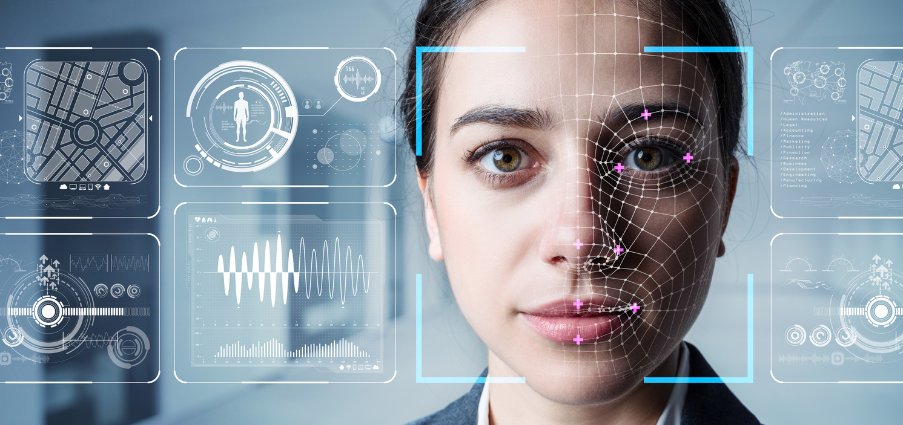
Facial Recognition
Facial recognition software is an extremely disruptive and controversial technology that use algorithms to pick out specific and distinctive detail on a person’s face just by having a picture of them.
Despite the many advantage that the technology can provide to society, it raises more questions than it is able to answer.
The vast amount of information that the world wide web provides is one of the main reason for the rise of facial recognition software.
In a world where our profile pictures are plaster all over the web, the emergence of facial recognition software represent various threats to our way of life.

Slide 3
Facial recognition benefits
The advancement of facial recognition software will greatly benefits businesses and corporation, but at the cost of their customers privacy.
Facial recognition software will be a valuable tool to the marketing industries.
Facial recognition software can be use by the government to keep us safe, but how much privacy is society willing to give up for security.

Slide 4
Facial recognition drawbacks
Research showed that “facial recognition technologies have misidentified individual people or struggled to recognize certain types of faces”
Furthermore, growing studies have show that the technology consistently miscategorized Black people, especially the women.
“One false match can lead to a wrongful arrest, a lengthy detention, and even deadly police violence”
Facial recognition industries usually illegally datamined all their pictures from social media sites like Facebook, YouTube, Venmo, and millions of other websites.

Slide 5
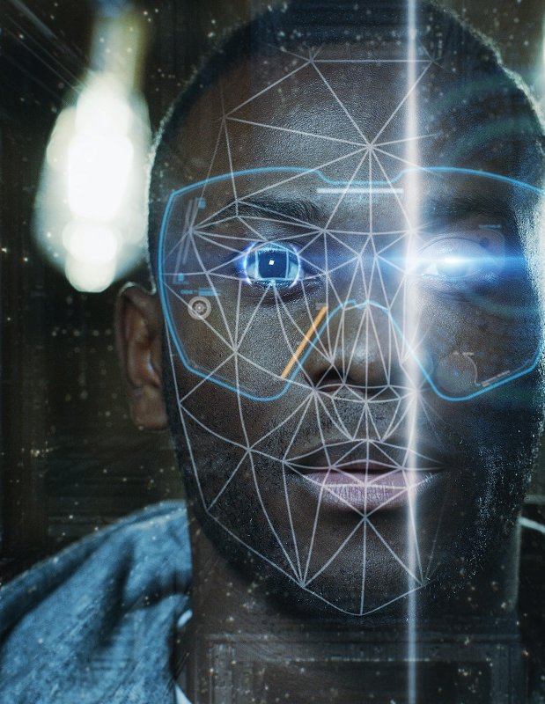
Facial recognition drawbacks cont.
Despite barely having any laws to regulate facial recognition software the government and law enforcement officials have been using it aggressively
it will enable people to have access to billions of people photos and information. It will eventually normalize surveillance in our society, profit will be at an all-time high, but privacy will be nonexistent
The use of Facial recognition software might lead us toward the dystopian society where the government is always watching us with no concern for our privacy.

Slide 6
Change in the development of community
Many times, law enforcers try to defend the usage of facial recognition software by saying that they provided small clues that help them solve a case, and that they do not use only facial recognition software to make an arrest, but over and over it has been proven that they use it as the sole evidence to lock someone away.
Despite their inaccuracy time and time again these facial recognition technologies have been deploying in the minority communities, which is putting already marginalize community at great risk.
The strong bonds that these communities form are important for society and our culture in order to progress because within those communities these people feel protected and can express their feeling freely.

Slide 7
Change in the development of community cont.
Facial recognition software can exacerbate a big problem that the Black communities is already facing, police brutality.
facial recognition technology might break those communities which will impede the development of our society.

Slide 8
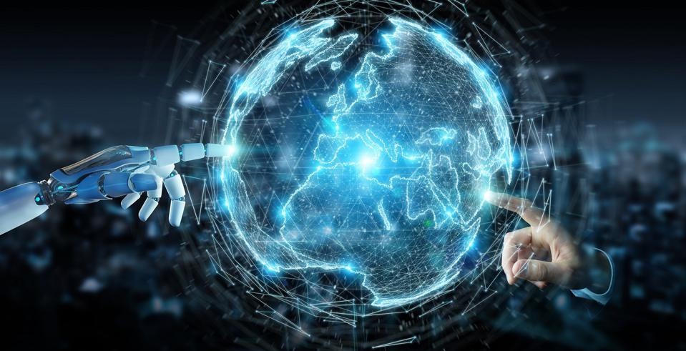
Speed and Scale
Facial recognition software might be able to act as “an add-on feature for surveillance cameras” (Hill, 2020).
This will allow the government to be able to use all the previous infrastructure that they are already have under their control, things like traffic lights, cameras in public places and social media.
By using those establish infrastructure which are already common in our society the technology will be able to diffuse at a rapid rate.
Facial recognition system will be able to rapidly archive millions of people into its servers by using traffic lights, public cameras, and social networks.
The ease of facial recognition software to interact with previous technologies, such as camera and video will make it quickly adaptable and highly scalable.

Slide 9
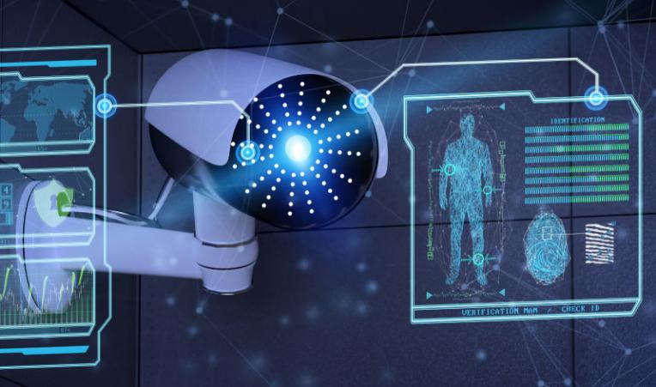
Changes in Culture
This will create a culture where everyone is worried that their pictures and videos are being used to influence their behaviors without their knowledge.
The facial recognition services that private corporation sell can be extremely damaging to our society and culture, especially one that depends so heavily on social media.
This emerging technology will impact the world, while simultaneously changing our culture.
The government usage of facial recognition software can tear the fabric of the American society while simultaneously disregarding the constitutional rights of the citizens.

Slide 10
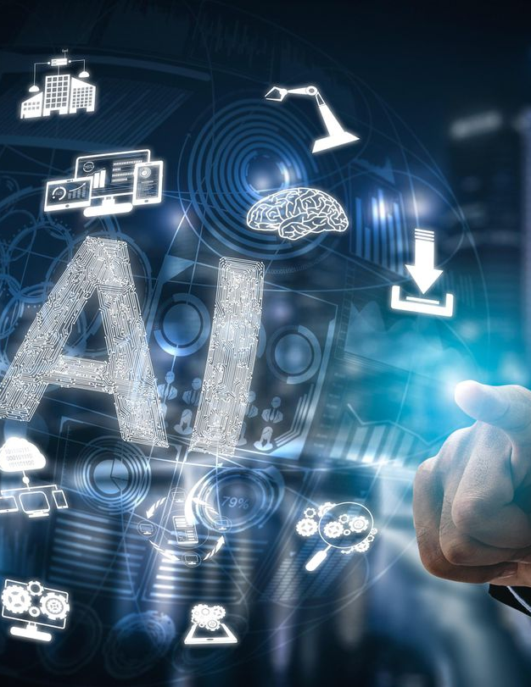
Disruptive Impact
Facial Recognition high scalability will allow them to impact millions of people, especially marginalize groups, which could undoubtedly have an ever-lasting effect on our society and culture.
The police are the ones using the software, which mean that it will spread widely, and their impact will be felt across every states.
The government using many facial recognition software without regulation prompt other corporation and businesses to use it without restrictions. This increases the scale and impact of the software massively.
This emerging technology will impact the world, while simultaneously changing our culture.

Slide 11
Predictions
I believe that people are quickly starting to become aware of how dangerous facial recognition might be, especially to minority groups.
People have been filing laws suit against companies that provided facial recognition software to law enforcement, and I expect that behavior to continue until the government create strong law to regulate the technology or ban it entirely.

Slide 12
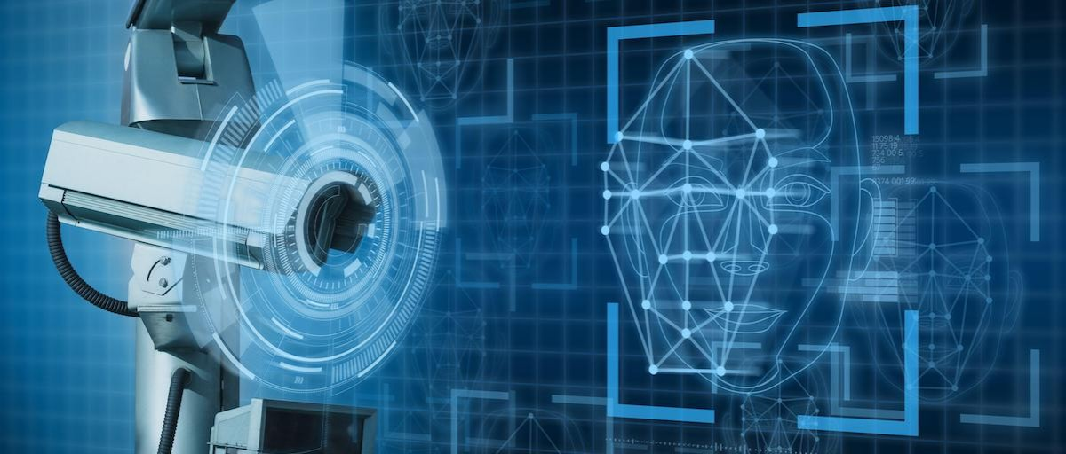
Prediction cont.
Although many people are attempting to ban it, I believe that since it can be really useful, the government will only limit its usage.
One of the main reason that I believe that the government might ban the technology altogether is because that many American see constant government surveillance as a severe breach of the constitution, the very foundation of the country.
If the government does not use the right laws to regulate facial recognition software, the era of cyber-surveillance will spread across the globe. That era will completely undermine the democracy that the U.S try so hard to build and maintain.

Slide 13
Appendix
Chayko, M. (2016). Chapter 3: Inhabiting a digital environment. In Superconnected: the internet, digital media, and techno-social life (pp. 39–62). essay, SAGE Publications, Inc.
Chayko, M. (2016). Chapter 6: Techno-socialization and the self. In Superconnected: the internet, digital media, and techno-social life (pp. 113–129). essay, SAGE Publications, Inc.
Chayko, M. (2016). Superconnected: The internet, digital media, and techno-social life. Thousand Oaks, CA: SAGE Publications.
Crockford, K.(2020, June 16). How is Face Recognition Surveillance Technology Racist? ACLU. https://www.aclu.org/news/privacy-technology/how-is-face-recognition-surveillance-technology-racist/
Digital Marketing Institute. (2019, May 3). How Do Social Media Algorithms Work? https://digitalmarketinginstitute.com/blog/how-do-social-media-algorithms-work
FaceFirst Face Recognition Software. (2019, May 9). History of Face Recognition & Facial recognition software. https://www.facefirst.com/blog/brief-history-of-face-recognition-software/.
Ghaffary, S. & Molla, R.(2019, December 10). Here’s where the US government is using facial recognition technology to surveil Americans. Vox. https://www.vox.com/recode/2019/7/18/20698307/facial-recognition-technology-us-government-fight-for-the-future
Ghaffary, S. (2019, August 9). How facial recognition became the most feared technology in the US. Vox. https://www.vox.com/recode/2019/8/9/20799022/facial-recognition-law
Gillespie, E. (2019, February 23). Are you being scanned? How facial recognition technology follows you, even as you shop. The Guardian. https://www.theguardian.com/technology/2019/feb/24/are-you-being-scanned-how-facial-recognition-technology-follows-you-even-as-you-shop

Slide 14
Appendix cont.
Hill, K.(2020, January 18). The Secretive Company That Might End Privacy as We Know It. The New York Times. https://www.nytimes.com/2020/01/18/technology/clearview-privacy-facial-recognition.html
Hill, K.(2020, January 18). The Secretive Company That Might End Privacy as We Know It. The New York Times. https://www.nytimes.com/2020/01/18/technology/clearview-privacy-facial-recognition.html
Jackson, J.(2020, July 2). ‘Face Recognition Risks Chilling Our Ability to Participate in Free Speech’. FAIR. https://fair.org/home/face-recognition-risks-chilling-our-ability-to-participate-in-free-speech/
Ng, A.(2020, October 24). Police are using facial recognition for minor crimes because they can. CNET. https://www.cnet.com/news/police-are-using-facial-recognition-for-minor-crimes-because-they-can/.
Oliver, J. [LastWeekTonight]. (2020, June 15). Facial Recognition: Last Week Tonight with John Oliver (HBO) [Video file]. https://www.youtube.com/watch?v=W-f4cea5oObY&ab_channel=LastWeekTonight
Samuel, S. (2019, November 15). Activists want Congress to ban facial recognition. So they scanned lawmakers’ faces. Vox. https://www.vox.com/future-perfect/2019/11/15/20965325/facial- recognition-ban-congress-activism
Smith, A. (2019, September 5). More Than Half of U.S. Adults Trust Law Enforcement to Use Facial Recognition Responsibly. Pew Research Center Internet & Technology. https://www.pewresearch.org/internet/2019/09/05/more-than-half-of-u-s-adults-trust-law-enforcement-to-use-facial-recognition-responsibly/.

